Slide 1


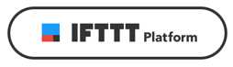
IoT with ESP8266
Rick Suel
Paul Goodjohn
Week of Learning 2018

Slide 2
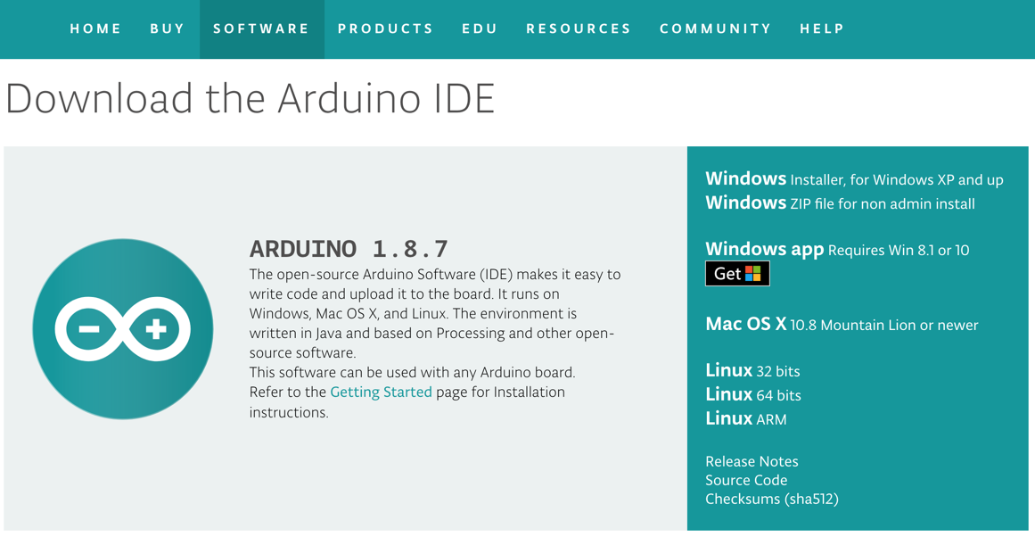

Class Pre-Work
Install latest Arduino software from:
https://www.arduino.cc/en/Main/Software
Install the Silicon Labs virtual com port (VCP) driver for your laptop’s operating system. This driver will allow your computer to recognize the ESP8266 device as a “com port” when you plug it in via USB.
https://www.silabs.com/products/development-tools/software/usb-to-uart-bridge-vcp-drivers
Create an account on Adafruit IO. This is the cloud platform we will be using:
https://io.adafruit.com/
Create an account on IFTTT. We will be using this platform to create events based on your device:
https://ifttt.com/
Get these links here: https://github.com/rdsuel/esp-class

Slide 3
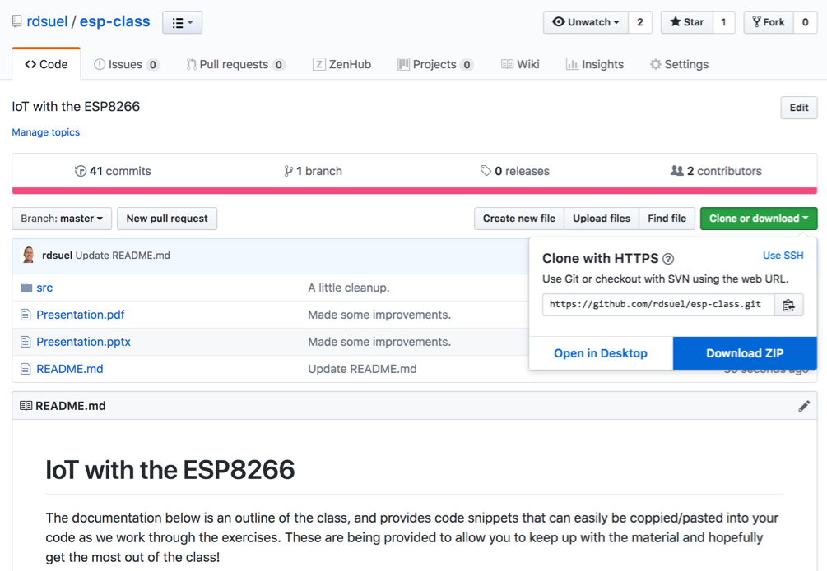
Class Materials
The source code and presentation for this course can be found here: https://github.com/rdsuel/esp-class

Slide 4
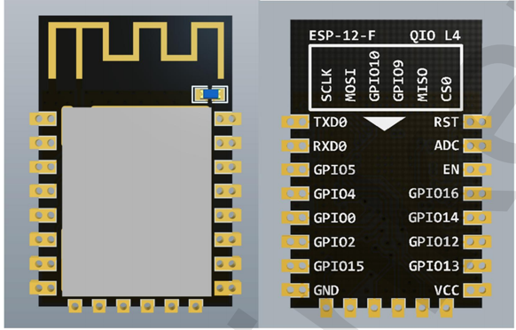
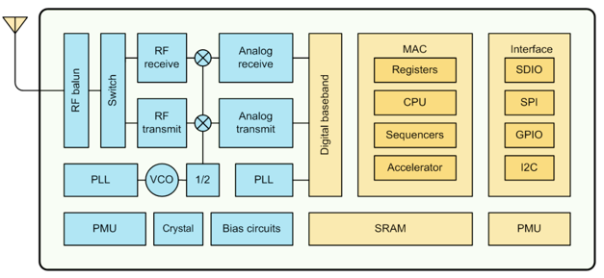
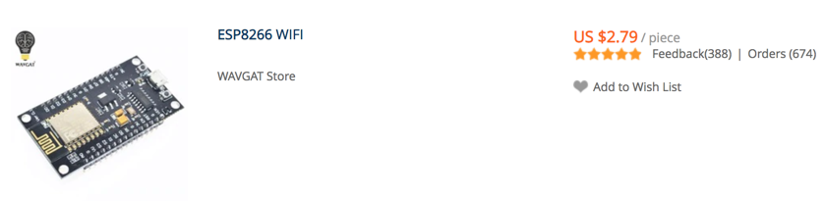
The ESP8266
http://esp8266.net/
http://esp8266.github.io/Arduino/versions/2.0.0/doc/reference.html

Slide 5
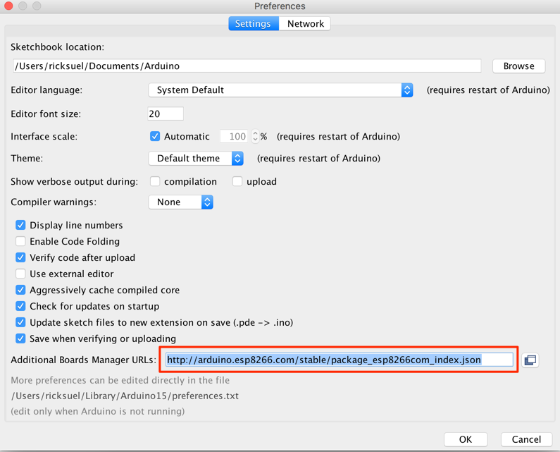
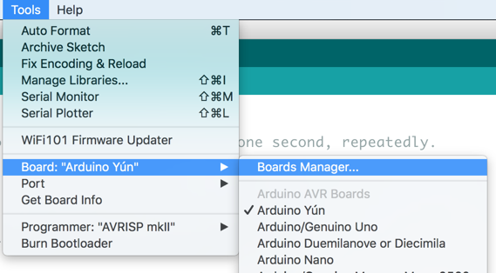
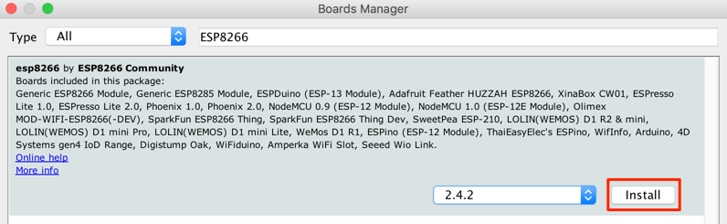
Setup
Add Boards Manager URL:
http://arduino.esp8266.com/stable/package_esp8266com_index.json
Install the ESP8266 boards package:
Tools → Board → Boards Manager

Slide 6
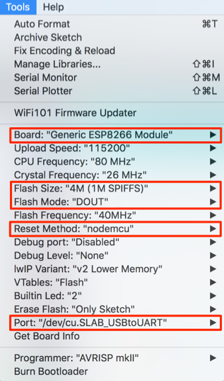
Setup (Continued)
Configure the connection parameters for the device:
Board: “Generic ESP8266 Module”
Flash Size: 4M (1M SPIFFS)
Flash Mode: “DOUT”
Reset Method: “nodemcu”
Port: choose the one for your device

Slide 7
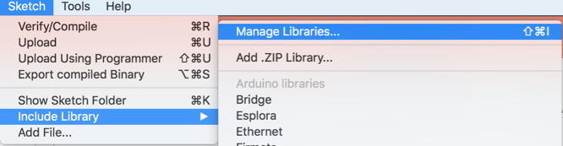
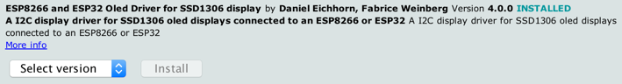
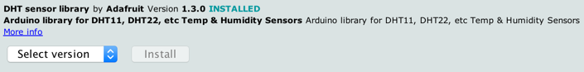
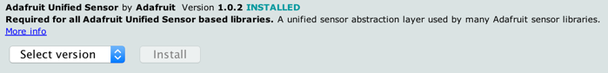
Install Arduino Libraries
We will need several libraries installed for this class:
Display Library (“ssd1306”):
Temp Sensor Libraries (“DHT” and “adafruit unified sensor”):

Slide 8
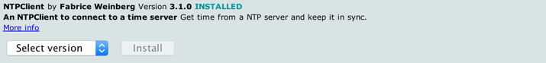
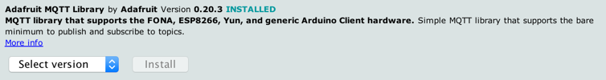
Install Arduino Libraries (Continued)
NTP Client Library for getting time over the internet:
Adafruit MQTT Library for sending data to https://io.adafruit.com

Slide 9
Exercise 1: Blinky
Goal:
Confirm you are able to load applications to your device by blinking the on-board LED.
Steps:
Load the ESP8266 → Blink example.
Switch over to the “scheduler-based” blink architecture. This will serve as the platform for the future exercises.

Slide 10
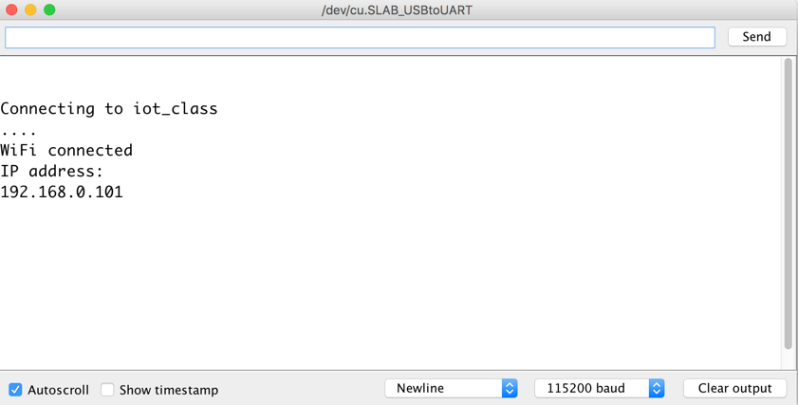
Exercise 2: Connect to Wifi
Goal:
Connect your device to the ”iot_class” network and print your IP address to the serial window.
Steps:
Update the “student.ino” template file so that it connects to the “iot_class”network. The password is “password”, so obviously it is very secure!
Once the device is connected, print the IP address to the serial window.
Congratulations, your esp8266 is now online. We’ll do more with this connection shortly!

Slide 11
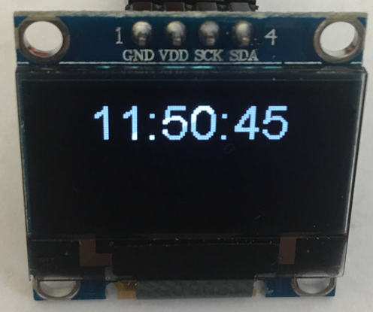
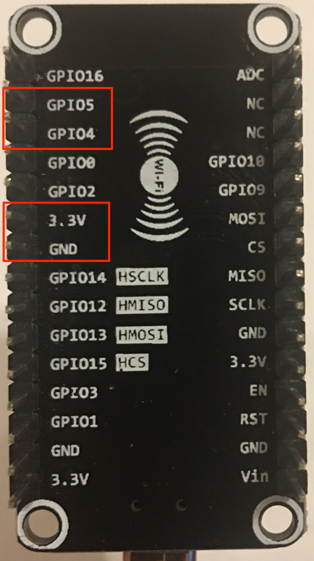
Exercise 3: OLED Display
Goal:
Add support for the OLED display and display the current by pulling it from the internet using an NTP server (time.nist.gov). Update the time every second.
Steps:
Wire the ESP8266 to the display as defined here:
Periodically read the time from the NTP server and write it to the display.
ESP8266 | Display
GPIO5 | SDA
GPIO4 | SCK
3.3V | VDD
GND | GND

Slide 12
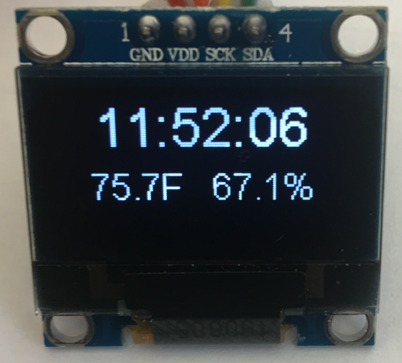
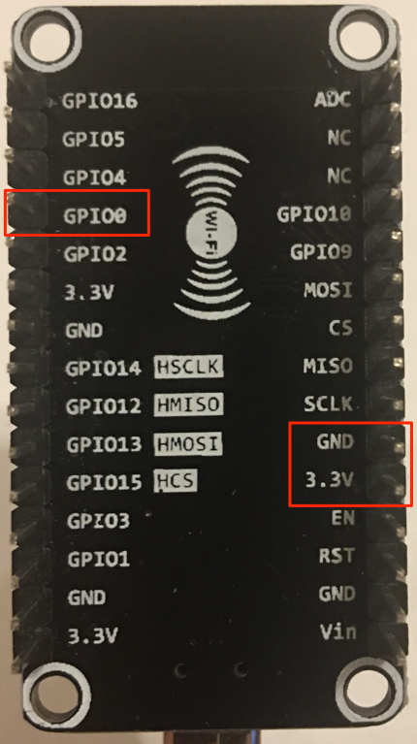
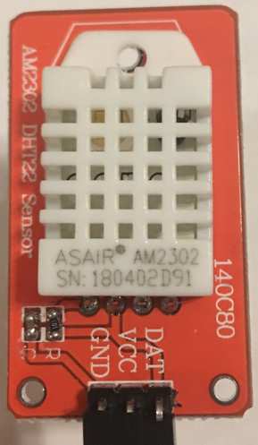
Exercise 4: DHT22 Temp/Humidity Sensor
Goal:
Add support for the DHT22 Temp/Humidity sensor. Display the temperature and humidity along with the current time on the OLED display.
Steps:
Wire the ESP8266 to the sensor as defined here:
Periodically read the temperature and humidity, and write them to the display.
ESP8266 | Sensor
GPIO0 | DAT
3.3V | VCC
GND | GND

Slide 13
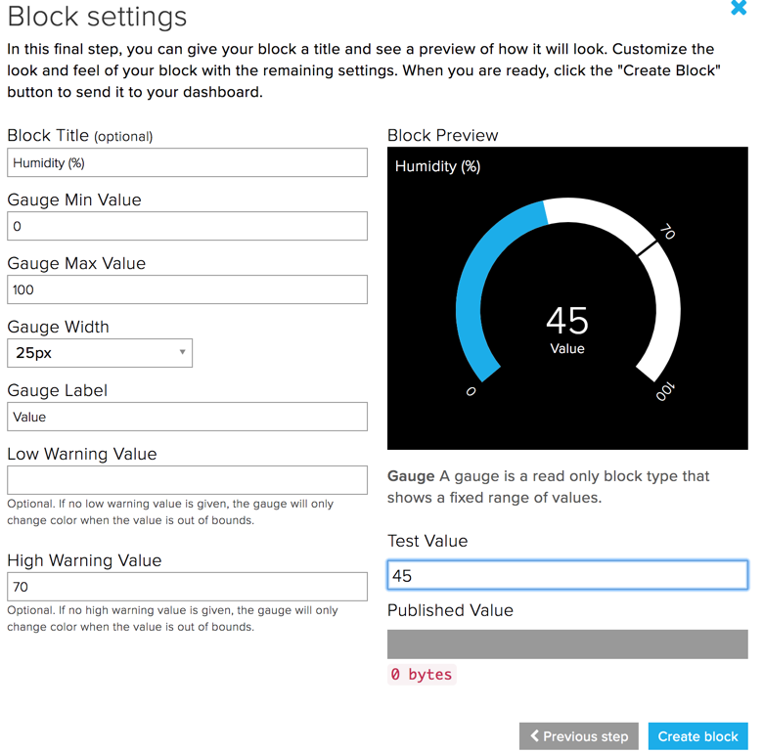
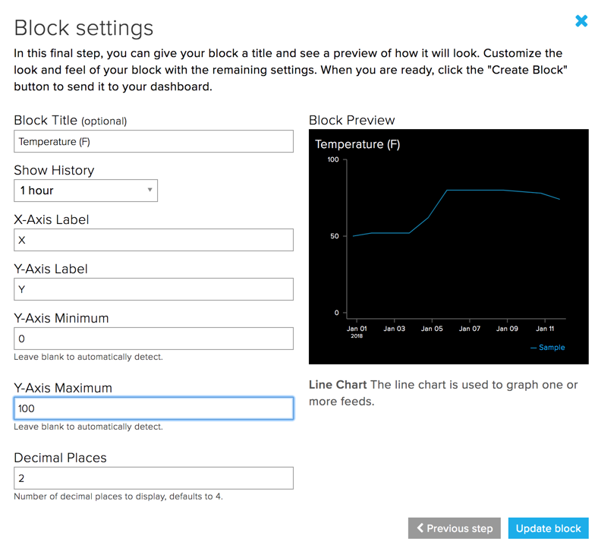
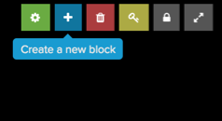
Exercise 5: Adafruit IO Cloud Platform
Goal:
Use MQTT to publish temperature and humidity values to the Adafruit IO platform, and create a GUI for displaying them.
Steps:
Log into https://io.adafruit.com.
Create a feed called “temperature”.
Create a feed called “humidity”.
Create a dashboard called “IoT Class”.
Add blocks to the dashboard for temp/humidity.
Add MQTT/adafruit support to your sketch.
Compile and upload to your device.

Slide 14


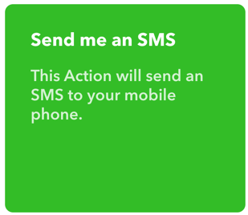
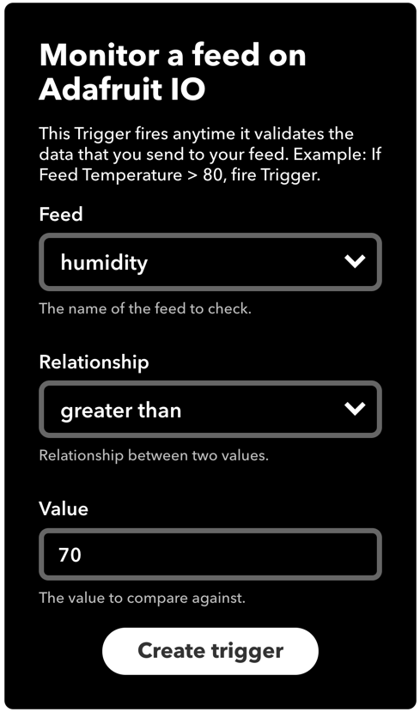
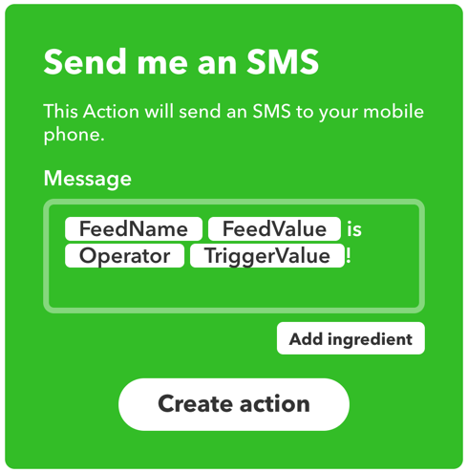
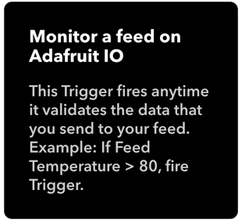
Exercise 6: IFTTT Humidity Alerts
Goal:
Create an IFTTT “applet” to send you a text message (or email) when the humidity exceeds 70%.
Steps:
Log into your https://ifttt.com account
Create this new applet:

